Slide 1

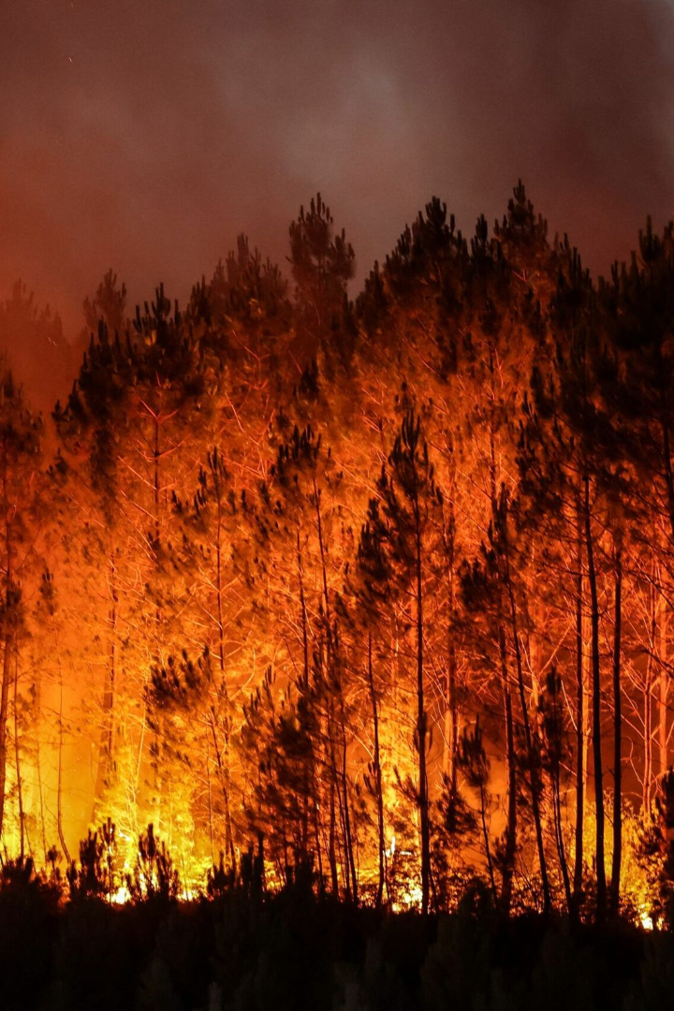


Forest Wildfire Analytics Using AWS
Wildfires are devastating, and it can take months for the forests to recover. That is why we need AWS for forest fire analytics. With this presentation, you'll learn how to prevent wildfires!
by Sanath Atturu

Slide 2
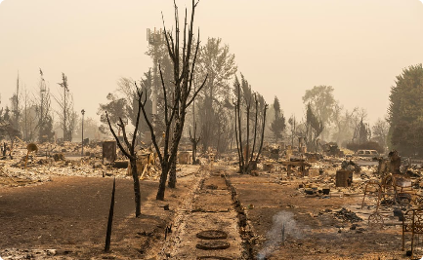
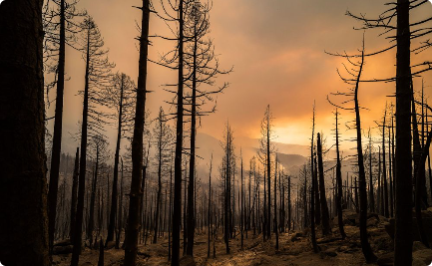
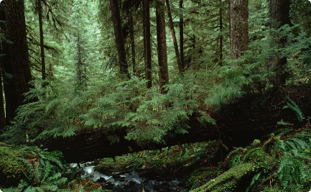
Introduction to Forest Wildfires
Dangerous Force
Cause and Effects
Types of Forests
Globally, wildfires consume 4-5 million square kilometers of land every year, and it's increasing.
The primary cause of wildfires is either lightning or human activities. The aftermath of wildfires can have long-lasting ecological and social impacts.
Forests can be broadly classified as coniferous, deciduous, or rainforests. Different forests have different susceptibilities to wildfire.

Slide 3
AWS for Forest Fire Analytics
Efficient
Economical
Forests, being large ecosystems, produce large volumes of data and processing becomes a challenging task. AWS offers a scalable infrastructure that can deal with all of that data and perform complex computations.
AWS provides cost-effective ways of storing, analyzing and visualizing the data.
Secure
Reliability
As forests are a sensitive ecosystem, data privacy is a concern. AWS ensures bullet-proof security measures and safekeeping of data.
With 24x7 service support, AWS ensures 99.9999% uptime. This means you don't have to worry about losing valuable data in case of service outages.

Slide 4
AWS Services for Predicting Forest Fires
AWS IoT Core
Real-time monitoring of forests can be performed with the help of sensors. These sensors can provide continuous feedback necessary to make predictions.
1
2
3
AWS Lambda
Amazon Kinesis
Automatically build and run AI models that can predict the occurrence and likelihood of forest fires.
With Kinesis, you can process and analyze a large amount of data from various sources in real-time, enabling quick decision-making.

Slide 5
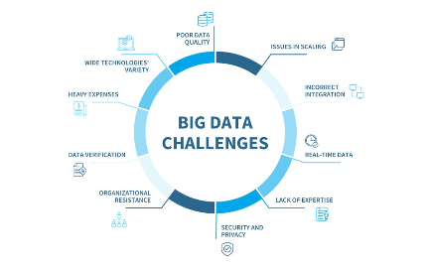
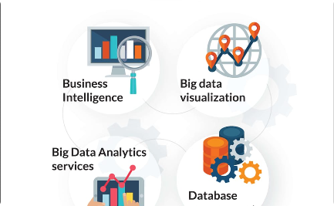

The Role of Big Data in Forest Fire Analytics
What is Big Data?
How does it Help?
Machine Learning
Big data is a term used to refer to datasets that are so vast and complex that traditional data handling techniques are insufficient.
Big data analytics can help identify patterns that can indicate the likelihood of a fire outbreak. This information can aid in preventing or reducing losses.
Machine Learning is critical for pattern recognition in big data, which is widely used in forest fire analytics.

Slide 6

Forest Fire Analytics Applications
1
Real-time Monitoring
2
Predictive Modelling
Real-time monitoring of the forests ensures immediate response in case of outbreaks, thus minimizing damage.
Using historical and live data, forest fire likelihood can be predicted, and preemptive measures can be taken to prevent the spread of fire.
3
Data Visualization
Visualization of data helps identify patterns and makes it easy to spot areas with the highest risk of forest fires.

Slide 7
Challenges in Forest Fire Analytics Using AWS
Compatibility
Data Volume
Data Quality
Data collected from various sources like sensors, image processing, topographic and weather data could come in different formats, making it challenging to analyze.
Identifying, storing, and processing large volumes of data is a challenge as it requires vast resources and technical expertise.
Data quality can be a challenge as the accuracy of the predictions depends on the quality of data fed into the system.

Slide 8

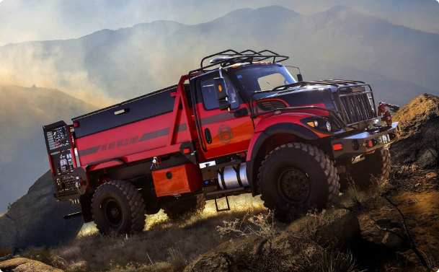
Conclusion and Key Takeaways
The way forward
Key Takeaways
Preventing wildfires is vital for ensuring that the forest ecosystem remains healthy. AWS has the capability to make your data work for you to ensure a better future.
AWS services are economical, secure, and reliable, making forest fire analytics an efficient process.
Predictive modeling using big data analytics is a game-changer for forest fire management.
Real-time data acquisition and processing are essential for early detection and prevention.

